Slide 1
SC2001 ‘Project 1’ {
title.py
contents.java
[Integration of Merge Sort & Insertion Sort]
< Group Members: Chelyn (U2523007F),
Ryan (U2522244E), Kyaw Lin (U2520058L) >
}
SC2001 Project 1

Slide 2
Table Of ‘Contents’ {
01
02
03
title.py
contents.java
Hybrid Algorithm
< MergeSort and InsertionSort Algorithm >
Time Complexity Analysis
Comparison
< Comparison with existing MergeSort >
}
SC2001 Project 1

Slide 3
Introduction; {
title.py
contents.java
<p Our Hybrid Algorithm implemented using python, using both Merge Sort and Insertion Sort, selecting based on the variable S >
</p>
}
SC2001 Project 1

Slide 4
01 {
[Hybrid Algorithm]
title.py
contents.java
< MergeSort and InsertionSort Algorithm >
}
SC2001 Project 1

Slide 5
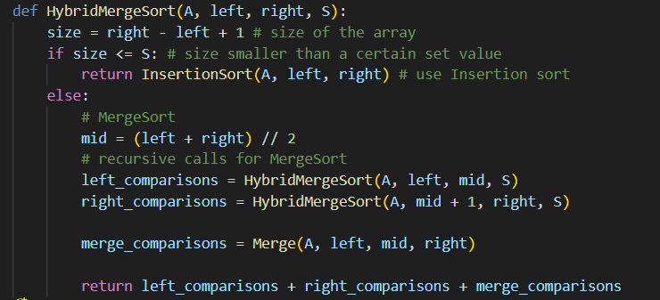
HybridMergeSort() {
title.py
functions.py
}
SC2001 Project 1

Slide 6
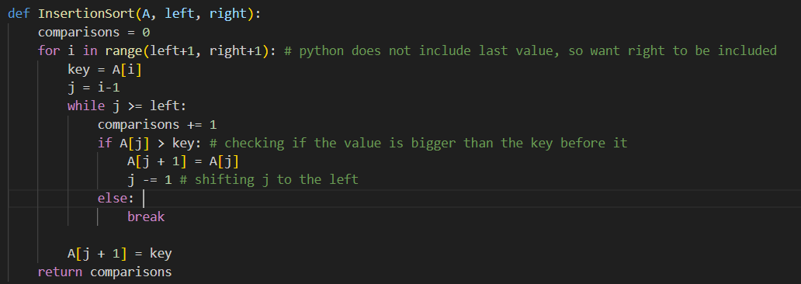
InsertionSort() {
title.py
functions.py
}
SC2001 Project 1

Slide 7
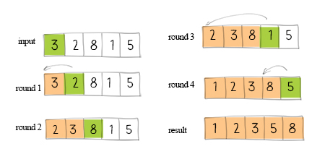
InsertionSort() {
title.py
functions.py
}
SC2001 Project 1

Slide 8
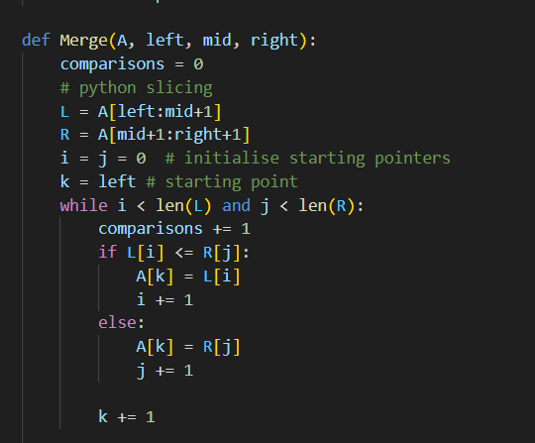
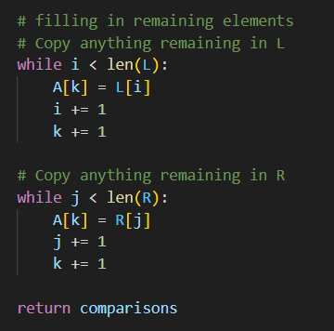
Merge() {
title.py
functions.py
}
SC2001 Project 1

Slide 9
02 {
[Time Complexity Analysis]
title.py
contents.java
}
SC2001 Project 1

Slide 10
Theoretical Analysis {
< Worst Case>
< Best case >
title.py
contents.java
(HybridSort)
n = number of elements, S = insertion sort threshold, 1 <= S <= n
n/S is the number of small subarrays produced
O(nS + n log​ n/S)
O(n + n log​ n/S)
}
SC2001 Project 1
Notes:
Size for each insertion sort algorithm needs to be bigger than 1 ands smaller than n for the splits
Insertion sort + mergesort based on value on S

Slide 11
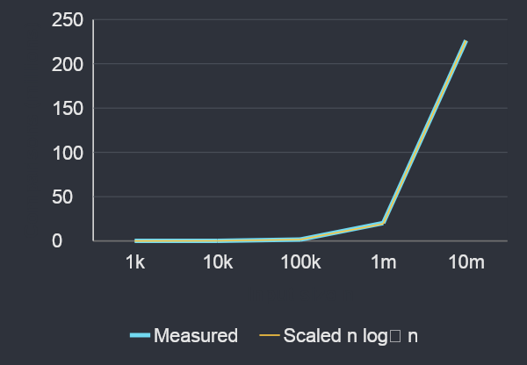
title.py
experiment.py
c(i): fixed S = 16 {
n | Comparisons
1,000 | 10,430
10,000 | 126,937
100,000 | 1,638,835
1,000,000 | 20,211,915
10,000,000 | 226,342,626
Comparisons / (n log₂ n): 0.96 to 1.05
With fixed S, the results support O(n log n)
}
SC2001 Project 1
Notes:
Insertion sort algorithm
Size for each insertion sort algorithm needs to be bigger than 1 ands smaller than n for the splits

Slide 12
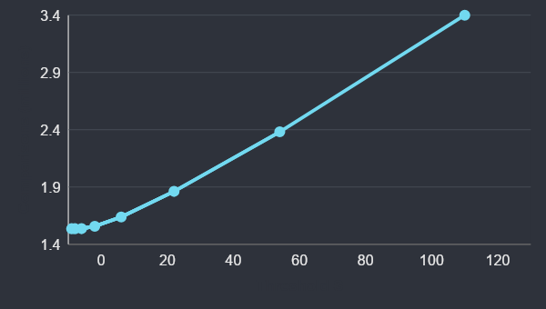
title.py
experiment.py
c(ii): fixed n = 100,000 {
Increasing S
Fewer merge levels
Larger insertion
subarrays
1.54m to 3.51m
comparisons
O(n log₂(n/S) + nS): insertion work dominates at large S
}
SC2001 Project 1
Notes:
Insertion sort algorithm
Size for each insertion sort algorithm needs to be bigger than 1 ands smaller than n for the splits

Slide 13
title.py
experiment.py
c(iii): CPU timing method {
n = 100,000 and 1,000,000
S = 1, 2, 4, 8, 16, 32, 64, 128
1. Copy the same unsorted input
2. Time HybridMergeSort only
3. Repeat three times and take the mean
Example: n = 1,000,000, S = 16
(1.71875 + 1.62500 + 1.68750) / 3 = 1.67708 s
}
SC2001 Project 1
Notes:
Insertion sort algorithm
Size for each insertion sort algorithm needs to be bigger than 1 ands smaller than n for the splits

Slide 14
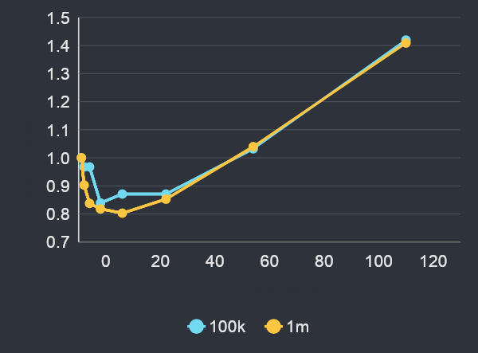
title.py
experiment.py
c(iii): measured CPU times {
S | 100k (s) | 1m (s)
1 | 0.1615 | 2.0885
2 | 0.1563 | 1.8854
4 | 0.1563 | 1.7500
8 | 0.1354 | 1.7083
16 | 0.1406 | 1.6771
32 | 0.1406 | 1.7813
64 | 0.1667 | 2.1719
128 | 0.2292 | 2.9427
Best tested: S = 8 at 100k; S = 16 at 1m
}
SC2001 Project 1
Notes:
Insertion sort algorithm
Size for each insertion sort algorithm needs to be bigger than 1 ands smaller than n for the splits

Slide 15
title.py
experiment.py
c(iii): threshold for part (d) {
Candidate: S = 16
Lowest mean at the largest tuning size
1,000,000 elements: 1.6771 CPU seconds
Fewer comparisons do not guarantee less time
S = 1: 18.67m comparisons, 2.0885 s
S = 16: 20.21m comparisons, 1.6771 s
Close timings vary. S = 16 is the best tested candidate.
}
SC2001 Project 1
Notes:
Insertion sort algorithm
Size for each insertion sort algorithm needs to be bigger than 1 ands smaller than n for the splits

Slide 16
03 {
[Comparison]
title.py
contents.java
< Comparison with existing MergeSort >
}
SC2001 Project 1

Slide 17
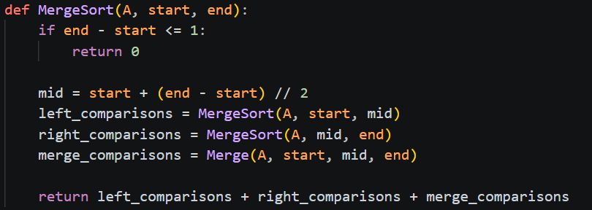
MergeSort() {
title.py
functions.py
}
SC2001 Project 1

Slide 18
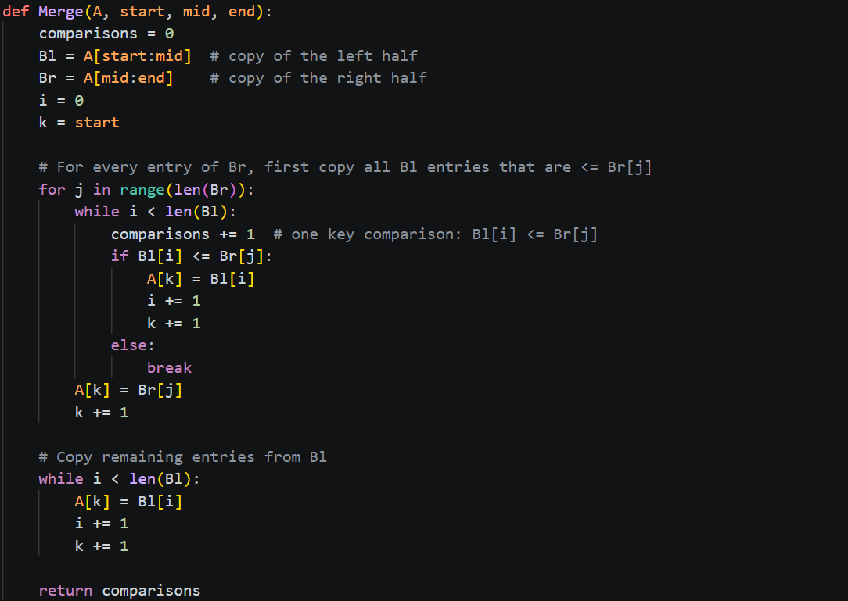
Merge() {
title.py
functions.py
}
SC2001 Project 1

Slide 19
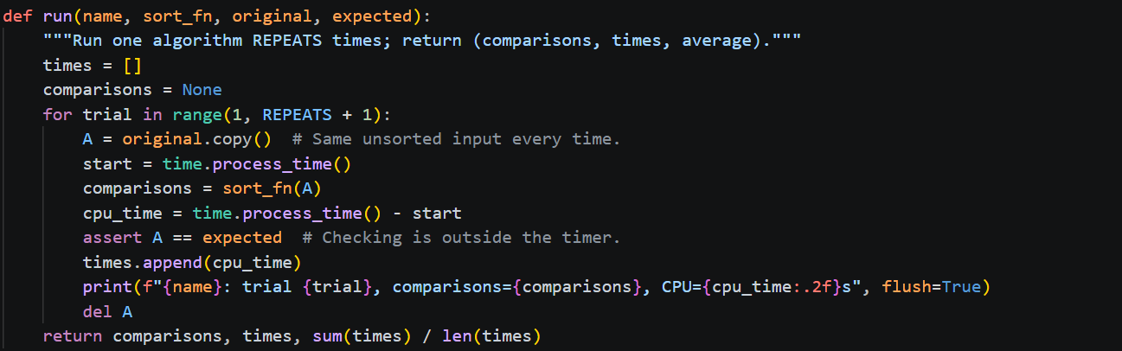
run() {
title.py
functions.py
}
SC2001 Project 1

Slide 20
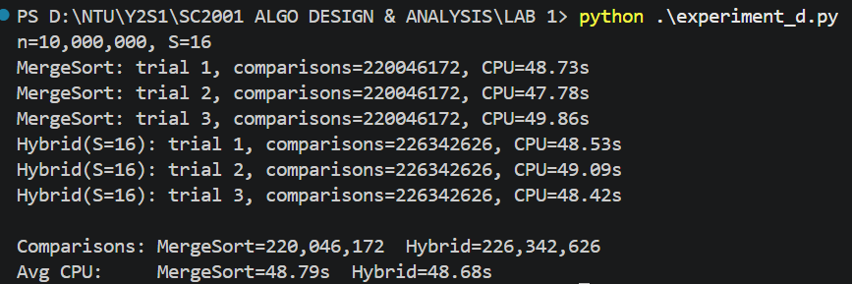
HybridMergeSort() vs MergeSort()
title.py
output.py
SC2001 Project 1

Slide 21
Conclusion {
title.py
contents.java
‘The hybrid algorithm has the same O(nlog⁡n) asymptotic complexity as merge sort when S is a fixed small value, but it may achieve a lower actual runtime by using insertion sort for small subarrays. The best threshold S should be determined experimentally. ’
}
Notes:
The hybrid algorithm improves the constant factors. Normal merge sort continues splitting until every subarray contains one element. Your hybrid algorithm stops at size SS and sorts each small subarray using insertion sort.
This can be faster because:
It makes fewer recursive calls.
Insertion sort has low overhead on small arrays.
Insertion sort often has better cache locality.
Insertion sort is especially fast when the small subarrays are nearly sorted.
However, choosing SS too large can make it slower because the insertion-sort cost grows as O(nS). For example, if S=nS=n, the algorithm becomes insertion sort and its worst case becomes O(n^2).

Slide 22
Thanks; {
title.py
contents.java
‘Do you have any questions?’
Q & A
}
SC2001 Project 1

